Slide 1
Chapter 13:
Introducing Evaluation

Slide 2
The aims
Explain the key concepts used in evaluation.
Introduce different evaluation methods.
Show how different methods are used for different purposes at different stages of the design process and in different contexts.
Show how evaluators mix and modify methods.
Discuss the practical challenges
Illustrate how methods discussed in Chapters 7 and 8 are used in evaluation and describe some methods that are specific to evaluation.

Slide 3
13.1 Intro
Evaluation --
  collects information about users’ or potential users’ experience interacting with a prototype or system.
  focuses on
    the usability (how easy to learn and use)
    the users’ experience (how satisfying, enjoyable ,or motivating)
Designers’ assumption
  If they can use the product and find it attractive, others will too.
  But designers are not like the target user population

Slide 4
13.2 Why, what, where and when to evaluate
Iterative design & evaluation is a continuous process.
13.2.1Why evaluate?
-- users expect a usable system and pleasing and engaging experience.
User experience:
  Meet the needs of the customer
    Simplicity and elegance – joy to own, joy to use
-- From a business and marketing perspective
  Designers can focus on real problem and needs of different user groups
  It enables problems to be fixed before sale

Slide 5
13.1.2 What to evaluate
What: 不同產品，要測試的功能也不同
  Early prototypes of a new system ~ screen function
  Aesthetic design ~ safety features
Different types of product with a range of features
  New web browser – items can be found faster
  Creativity support tool for teaching story writing
  Makers of toys
  Music player – color, shape, size
  company – market reaction to new website

Slide 6

13.1.3 Where to evaluate
Where: in natural and laboratory
settings.
Lab
  Provides control to investigate if requirement are met
  Test design choices (size, layouts)
Natural setting
    Online behavior, such as social networking (love match)
Living lab
  Setting off environment but also giving the ability to control, measure, and record activities.

Slide 7
13.3 Types of Evaluation
Three categories of evaluation
1. Controlled settings involving users, e.g. usability testing & experiments in laboratories and living labs.
Pro: revealing usability problem
Con: not able to capture context of use
2. Natural settings involving users, e.g. field studies to see how the product is used in the real world.
Pro: real setting
Con: expensive and difficult to conduct
3. Any settings not involving users, e.g. consultants critique; to predict, analyze & model aspects of the interface analytics.
Pro: cheap and quick
Con: can miss unpredictable usability problem & user experience

Slide 8
13.3.1 Controlled settings involving users
Good --
  to control what users do ,when they do it, for how long.
  reduce distractions.
Usability testing:
  Combination of methods – experiments, observation, interview, questionnaires
  Goal: determine whether an interface is usable by the user to carry out tasks.
  Record: time, error
    Video, logging software -- interactions with software

Slide 9
  Findings from testing: are summarized in a usability specification (see 補充).
Experiments:
  Test hypotheses in controlled setting
  Condition
  Aim of experiment: test which one is more effective
  Data are analyzed

Slide 10
13.3.2 Natural setting involving users
Aim: evaluate people in their natural settings, to
  Help identify opportunities for new technology
  Establish the requirements for a new design
  Facilitate the introduction of technology
  Inform deployment of existing technology in new context
Methods: observation, interview, logging
Data: audio/video recording (by researcher), diaries, notes (by user).
Goal: unobstrusive and not to affect people

Slide 11
Wild studies in HCI and ubiquitous computing
Look how new tech. or prototypes have been deployed in various setting (outdoor, public places, home)
  EX. 電子書實例、mobile navigation device
Recorded by participants
  Diary, online forms，interview
Users not try out the full range of functions (researchers不知是否useful and usable)
Field studies Can be virtual
Games, online communication, chat rooms…
Goal: examine social processes occur in them (collaboration , confrontation…)

Slide 12
13.3.3 any settings not involving users
Researchers imagine or model how an interface is used
Inspection methods:
  Heuristic evaluation
  Cognitive walkthroughs
  Analytics and models

Slide 13
Heuristic evaluation
  For screen-based application
Cognitive walkthroughs
  Involving simulating a user’s problem-solving process
  check to see how users progress from step to step
Analytics and models
  Use technique for logging data at a customer’s site or remotely.
  Internet data – understand web usage
  Useful for evaluating design features of websites
Models
  Comparing the efficacy of different interfaces for the same application (如介面功能的擺放位置)

Slide 14
13.3.3 choosing and combining methods
  Used to get a broad understanding of the efficacy of a design. 廣泛了解設計功效
  Fig. 13.1 FS (測試點子) --- usability test (測試特殊功能) --- Field Study (測試在自然情境中的狀況)
13.3.4 Opportunistic evaluations 機會點評估
  Done early to provide designers with feedback quickly about a design idea. 再決定是否製作雛形
  Informal
  Ask local users’ opinions

Slide 15
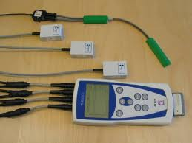
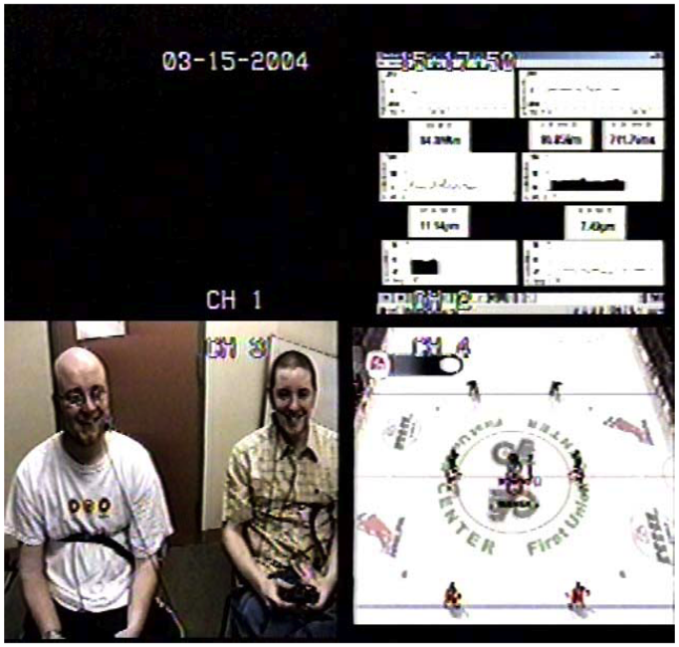
13.4.1 Challenge & engagement in a collaborative immersive game
生理測量 Physiological measures were used to measure user experience (challenge, engagement).
比較主觀感受與生理測試 (性別 vs.恐懼)
Players were more engaged when playing against another person than when playing against a computer.
had to take?

Slide 16

13.4.2 in the wild study of skiers
Evaluate whether /how skiers use a mobile device to improve their performance – how a mobile system was used by the skiers
Ski trials
  Data: video clips, data from the accelerometers 加速計
  Record: when / how often they consult their smartphones
  Finding: did not use it on the slopes but in the bar.
Focus group (a week a later)
  Preference, problems using the equipment on the slopes

Slide 17
13.5 What did we learn from the case studies?
BOX 13.3 The language of evaluation
Analytical evaluation
bias
Controlled experiment
Crowdsourcing
Ecological validity
Field study
Formative evaluation
Heuristic evaluation
Predictive evaluation
Summative evaluation
Usability laboratory
User studies
Usability studies
Usability testing
User testing
…

Slide 18
13.6 Other issues to consider whent doing evaluation
13.6.1 informing participants about their rights and getting their consent
  研究倫理
  金賽博士，電擊，史丹福監獄實驗
13.6.2 some things that influence how you interpret data
信效度
Ecological validity生態效應
  環境因素如何扭曲測試結果
  Hawthorne effect 霍桑效應

